Slide 1

Implement Serialization in HtmClassifier
Software Engineering - WS 2022/2023
Examiner : Damir Dobric / Andreas Pech
Presented by
Amith NAIR (1428869)
Aneeta Antony(1431461)
ROHIT SURESH (1469271)

Slide 2
CONTENT
CONTENT
Introduction
Objectives
Methods
Approach
Output
Reference

Slide 3
INTRODUCTION
Serialization is the process of converting an object into a stream of bytes to store the object or transmit it to memory, a database, or a file. Its main purpose is to save the state of an object in order to be able to recreate it when needed. A classifier, in machine learning, is an algorithm that automatically assigns data points to a range of categories or classes.
Our task is to implement serialization of HTM classifier.
To demonstrate how serialization is implemented in HTM classifiers, with the help of Unit tests.

Slide 4
OBJECTIVES
Identify the parameters to be serialized in HtmClassifier class.
Implement interface ISerializable
Create Serialization() and Deserialization() methods
Override Equals method in HtmClassifier class for Equality checks.
Deserialize and verify results of 2 instances of HtmClassifier class.

Slide 5
METHODS
Serialization
- Converts and saves the current state/values of various parameters of HtmClassifer to a file.
- When required the application can save values to a file with the help of Serialize() method.
- Two parameters exists for now in HTMClassifier for serialization.
Deserialization
- When required we can read the Saved values from a file and set to the
HtmClassifier parameters with the help of Deserialize() method.
Parameters identified are:
m_AllInputs :- Dictionary keyValue param contains a List<int[]> as values and any String Key. There are basically the SDR of the input calculated as int array.
maxRecordedElements :- Is used to limit the number of latest SDR which will be recorded.

Slide 6
APPROACH
Step 1: Serialization() created
An object or data structure is serialized when it is put into a format that makes it simple to store or send across a network.
The serialization of the object supplied as an input parameter and writing of the serialized data to a stream are the two functions of the Serialize method.
Step 2 : HtmClassifier parameters Serialized and verified
The HtmClassifier parameters need to be serialized and the saved stream of date should be same as the current state of the object.

Slide 7
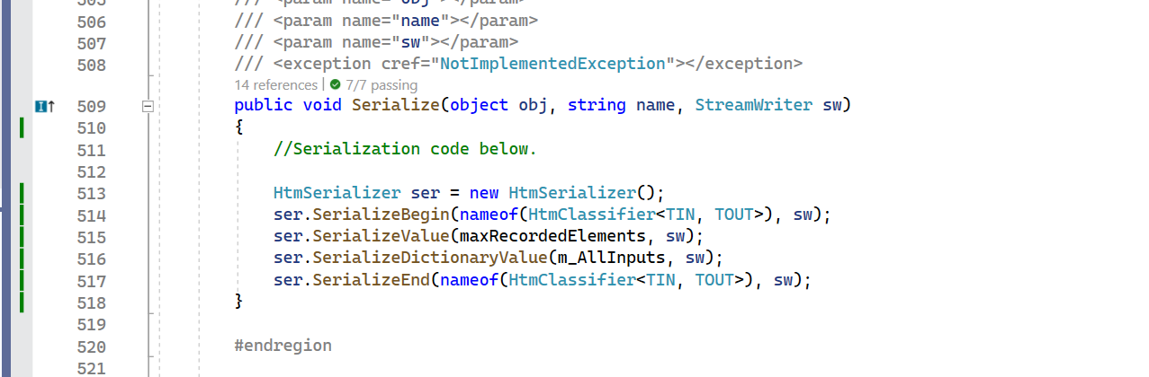

Slide 8
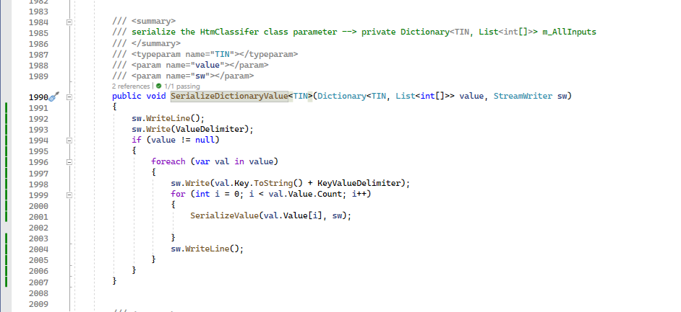

Slide 9
APPROACH
Step 3: Deserialization () added
Deserialization method carefully reads the values from a file and allocate it to the HtmClassifier instance parameters in proper order.
Step 4 : Deserialize and verify
Use the saved Serialize .txt file to create back the HtmClassifier instance.
Verify if the values are populated in proper order as expected.
The Dictionary keyValuePair had value in form of List<int[]> .The value from the data stream is iterated and properly obtained.

Slide 10
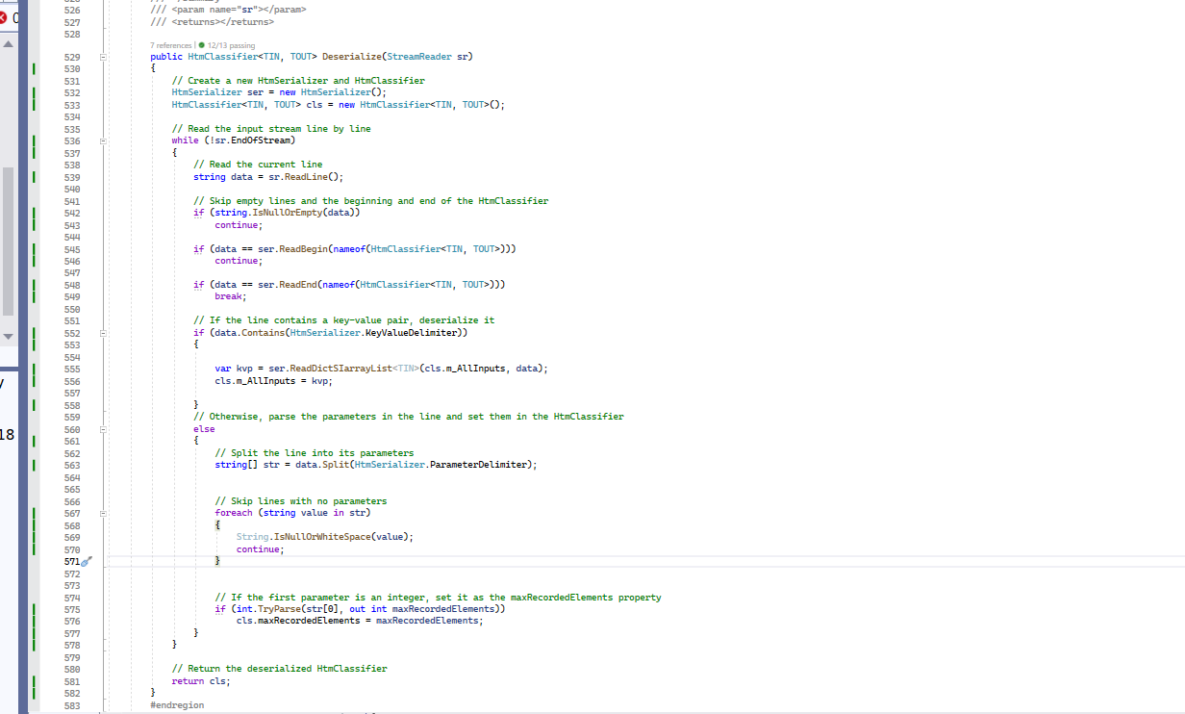
Unit Test Coverage.

Slide 11
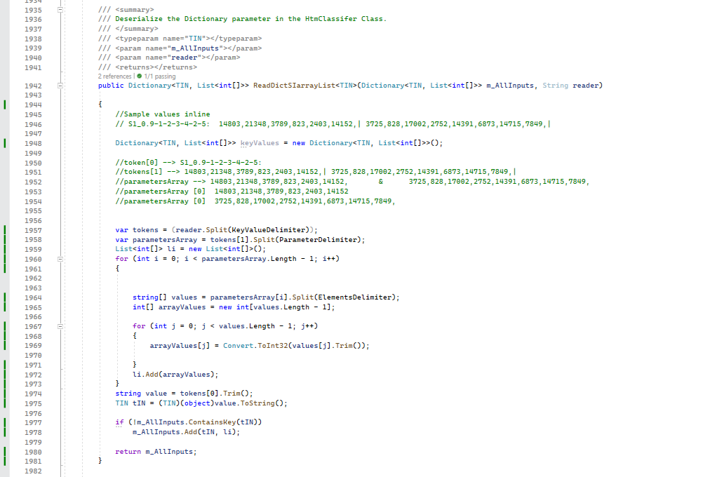

Slide 12
APPROACH
Step 5: Equals() method
In order to check the equality of two instances of the Classifier we need to override the object Equals() method.

Slide 13
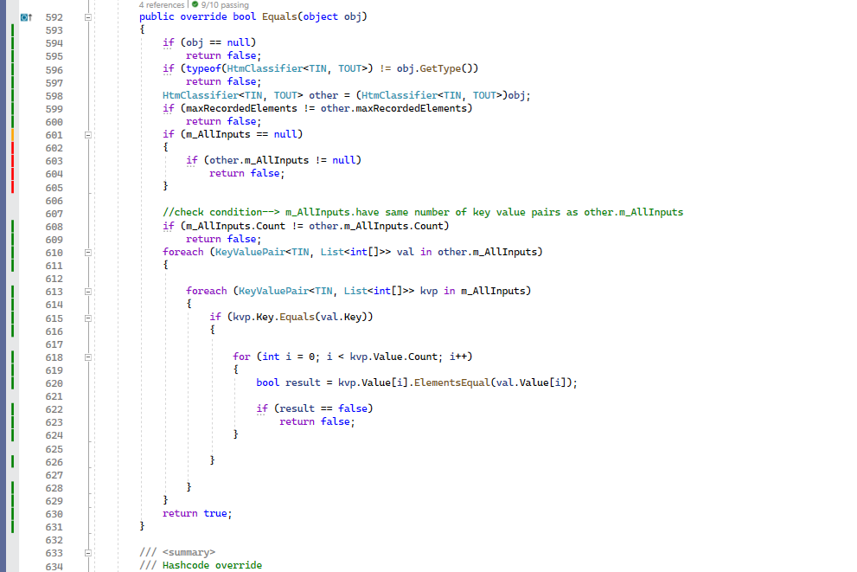

Slide 14
APPROACH
Step 6: UnitTest for Verification
Adding proper unit Testing to verify the serialization as well as deserialization.
Equals method was override for HTMClassifer
Step 7 : Added Possible UT Coverage
Enough Test case was added to verify all the new methods added while coding.

Slide 15
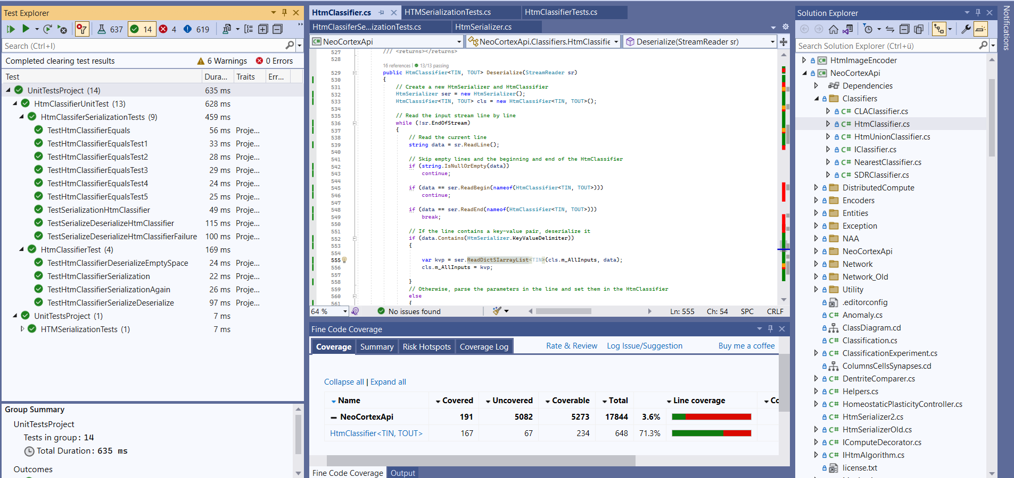
UNIT TEST COVERAGE

Slide 16

CONCLUSION
Serialization implemented for the HtmClassifier class.
This could help in keeping the state of HTM Classifier object in a file or transmit it across the network for using it in the future.
This helps us to reuse the object in different programs or even in different environments.

Slide 17
Discussion/Further Steps
We could think of extending this serialization to be saved in any DB ,could be used to retrieve to deserialize on application resume application from stop.
We could identify the possibility of improving time taken for (de)serialization
Try out serializing to other formats like JSON or XML.

Slide 18
REFERENCE
[1] G. K. F. Z. Jahan Balasubramaniama, "Enhancement of Classifiers in HTM-CLA Using Similarity Evaluation Methods," International Conference on Knowledge Based and Intelligent Information and Engineering Systems.
[2] J. &. G. D. Hawkins, "Hierarchical temporal memory including HTM cortical learning algorithms," The handbook of brain theory and neural networks, pp. 147-151, 2009.
[3] Hawkins and Ahmad, "provide a comprehensive overview of Hierarchical Temporal Memory (HTM) systems and their use of Sparse Distributed Representations (SDRs) as the fundamental data structure.," 2016.
[4] Y. A. S. H. J. &. C. Y. Cui, "Hierarchical temporal memory for anomaly detection in crowded scenes," IEEE Transactions on Circuits and Systems for Video Technology, pp. 385-393, 2016.
[5] [Online]. Available: https://github.com/antonyaneeta/neocortexapi/blob/team_alpha/source/NeoCortexApi/Classifiers/HtmClassifier.cs.
[6] [Online]. Available: https://github.com/antonyaneeta/neocortexapi/blob/team_alpha/source/UnitTestsProject/Classifiers/HtmClassiferSerializationTests.cs.
[7] Serialization in C#. Available on Serialization (C#) | Microsoft Learn

Slide 19
Thankyou !

